Slide 1

Adopting the Open Source Model
David Sietz
Software Developer / Architect
Reference Material
https://github.com/dsietz/open-source-model

Slide 2
1
defining ownership
2
open source contribution models
3
implementing open source in the enterprise
4
pitfalls & anti-patterns

Slide 3
1
defining ownership
2
open source contribution models
3
implementing open source in the enterprise
4
pitfalls & anti-patterns

Slide 4






defining ownership
OWNER
OWNER
solution
business
customer
OWNER
IT management
OWNER
development

Slide 5
organizational alignment for hybrid-shared services
development
(director)
application development
(manger)
product A
(manager)
product B
(manager)
infrastructure services
(manger)
networking
Financial
(director)
build & deploy
services
(manger)
provisioning
middleware
expense department
(manager)
software expenses
builds
deploys
security services
(manger)
internet
identification
OWNER
OWNER
OWNER
OWNER
OWNER

Slide 6
organizational alignment for product teams
development
(director)
product A
- manager
- network
- provisioning
- middleware
- build
- deploy
- support
- financials
Financial
(director)
expense department
(manager)
product B
- manager
- network
- provisioning
- middleware
- build
- deploy
- support
- financials
OWNER

Slide 7

traditional considerations
1. Cost
development / purchase
infrastructure
implementation
maintenance
2. People
knowledge
maintenance
retention
3. Adoption
technology
functionality
customization
longevity

Slide 8

considering ownership
leader
team
customer
vendor
solution

Slide 9
considering ownership
leader
team
customer
OWNER
vendor
solution

Slide 10
considering ownership
leader
team
customer
I wish to register a complaint!
vendor
OWNER

Slide 11


software ownership
home grown
vendor product
 | Home Grown |  |  |  | Vendor
meets requirements | l |  |  |  | l
customizable | l |  |  |  | l
time to market | l |  |  |  | l
cost | l |  |  |  | l
support | l |  |  |  | l

Slide 12
software ownership
home grown
vendor product
 | Home Grown |  |  |  | Vendor
meets requirements | l |  |  |  | l
customizable | l |  |  |  | l
time to market | l |  |  |  | l
cost | l |  |  |  | l
support | l |  |  |  | l
financially vested | l |  |  |  | l
technical direction | l |  |  |  | l

Slide 13


software ownership
home grown
open source
vendor product
 | Home Grown | Internal OS | Open Source | Enterprise OS | Vendor
meets requirements | l | l | l | l | l
customizable | l | l | l | l | l
time to market | l | l | l | l | l
cost | l | l | l | l | l
support | l | l | l | l | l
financially vested | l | l | l | l | l
technical direction | l | l | l | l | l

Slide 14
open source benefit
product A
shared service
product B
solution
OWNER

Slide 15

open source benefit
product A
shared service
product B
solution
OWNER

Slide 16

open source benefit
product A
shared service
product B
solution
solution
solution
OWNER
OWNER
OWNER

Slide 17
open source benefit
product A
shared service
shared service
shared service
product B
solution
solution
solution
OWNER
OWNER
OWNER

Slide 18
open source benefit
product A
product B
Allows for organic change of organizational structure to support product teams
solution
solution
OWNER
OWNER

Slide 19
1
defining ownership
2
open source contribution models
3
implementing open source in the enterprise
4
pitfalls & anti-patterns

Slide 20



open source contribution models
contribution
distributed
centralized
Bottleneck | Flood Gate
Voting | Discussion
Default to “No” | Default to “Yes”
BDFL
Benevolent Dictator for Life
Meritocracy
Liberal Contribution

Slide 21
open source contribution models
BDFL
Benevolent Dictator for Life
Meritocracy
Liberal Contribution

Slide 22
Benevolent Dictator for Life
BDFL
Benevolent Dictator for Life
Ownership | centralized leadership / governance limited democracy centralized roadmap / direction
Usage | direct custom product early stages of open source project
Pros |  | Cons
adherence to standards controlled spend / ROI custom profile focused |  | reduced innovation high support obligation shorter “shelf life”

Slide 23




Benevolent Dictator for Life
solution
customer
controlled

Slide 24



Benevolent Dictator for Life

Slide 25

Benevolent Dictator for Life
Use Cases
adherence to a “vendor product” policy
technical standards
dependent on 3rd party licensing or support contract
product owned by shared service department
compliance to policies and procedures
centralize knowledge or technical skill set
organizational structure mirrors Waterfall development
“infancy stage” of the solution
A solution is provided by a team for the mass consumption.

Slide 26
BDFL Agreement
Contributing
We are glad that you’d like to help contribute to this open source project!
We are currently following the Benevolent Dictator For Life contribution model. How to contribute is based on the following roles:
Adopter
You are welcome to download the product(s) and its source code for your use. By doing so, you are agreeing to the following responsibilities:
Adhere to the usage agreement
Report any bugs, enhancement requests, or product suggestions using our request system
Submit any questions or comments for discussion about the product(s) in our user forum

Slide 27
open source contribution models
BDFL
Benevolent Dictator for Life
Meritocracy
Liberal Contribution

Slide 28
Meritocracy
Meritocracy
Ownership | earned leadership / governance democratic process (voting) adaptive roadmap / direction
Usage | general product for mass adoption mature open source project
Pros |  | Cons
emerging technologies ROI based general public focused reduced support obligation longer “shelf life” |  | monetary ties limited innovation favored contribution

Slide 29
Meritocracy
solution
customer
customer
controlled
invested
customer

Slide 30


Meritocracy

Slide 31
Meritocracy
Use Cases
development based on customers’ requests
departments that have the time and people to invest
development based on priority
product owned by a community
common problem
common technical skills
common direction
“mature stage” of the solution
general release
high adoption rate
A solution is offered by a common community for general consumption.

Slide 32
Meritocracy Agreement
Contributing
We are glad that you’d like to help contribute to this open source project!
We are currently following the Meritocracy contribution model. How to contribute is based on the following roles:
Adopter
You are welcome to download the product(s) and its source code for your use. By doing so, you are agreeing to the following responsibilities:
Adhere to the usage agreement
Report any bugs, enhancement requests, or product suggestions using our request system
Submit any questions or comments for discussion about the product(s) in our user forum
Developer
If you would like to join our project team and contribute to the development of our product(s), you are welcome to follow these steps:
Inform the project team that you are working on a specific bug or enhancement by adding yourself as a developer
Fork our repository
Make the necessary code changes in your repo
Ensure that our testing strategy and standards are adhered as part of your development
Submit a properly formatted pull request (in accordance to our pull request standards) to merge your changes to our development branch
Upon approval of your pull request, we will merge your code into our integrated branch and our release notes

Slide 33
open source contribution models
BDFL
Benevolent Dictator for Life
Meritocracy
Liberal Contribution

Slide 34
Liberal Contribution
Liberal Contribution
Ownership | social governance community discussion consensus on roadmap / direction
Usage | evolving product complex solutions
Pros |  | Cons
low cost high innovation very low support obligation evolving technology |  | unknown “shelf life” requires open communication practices lack of product direction

Slide 35

Liberal Contribution
community
interest
customer
solution

Slide 36



Liberal Contribution

Slide 37
Liberal Contribution
Use Cases
development based on common interests or needs
technology
problem
high rate of innovation
experimentation and new technologies are encouraged
available “pool of users” to provide feedback and contributions
product owned by general public
organizational structure mirrors agile product teams
mature collaborative environment
compliance and support are conducted in product teams
A solution is available due to the joint efforts of community members based on their common interest or need.

Slide 38
Liberal Contributor Agreement
Contributing
We are glad that you’d like to help contribute to this open source project!
We are currently following the Liberal Contributor model. How to contribute is based on the following roles:
Adoption
You are welcome to download the product(s) and its source code for your use. By doing so, you are agreeing to the following responsibilities:
Adhere to the usage agreement
Adhere to our Code Of Conduct
Submit any questions or comments for discussion about the product(s) in our user forum
Development
To contribute to this project and its product(s) follow these steps:
Fork our repository
Make the necessary code changes in your repo
Submit a properly formatted pull request to merge your changes to our master branch
Testing
To contribute to the quality of this project and its product(s) follow these steps:
Fork our repository
Make the necessary test changes in your repo under the ./src/test directory
Submit a properly formatted pull request to merge your changes to our master branch
Documentation
To contribute to the clarification of this project and its product(s) follow these steps:
Fork our repository
Make the necessary document changes in your repo under the ./src/docs directory
Submit a properly formatted pull request to merge your changes to our master branch
NOTE: Automated compilation (build, testing, etc.) will be conducted when a pull request is submitted and merged upon success.

Slide 39
1
defining ownership
2
open source contribution models
3
implementing open source in the enterprise
4
pitfalls & anti-patterns

Slide 40
building blocks
people
communication
product
delivery
people

Slide 41
people
understand and adopt the open source model
advantages and disadvantages of open source
contribution models and responsibilities
solid understanding of the product
what is the problem to solve
minimal viable product (MVP)
interpersonal skills to collaborate
receptive to alternatives and new ideas
shun hording of knowledge (A.K.A. job security)
technical skills to advance the product
self motivated to learn
depth & breadth (T-Shirt)

Slide 42
building blocks
people
communication
product
delivery
communication

Slide 43
communication
open culture
no retribution for raising concerns
professional dialog
collaborative platform
user forum
support (A.K.A. issue tracking)
developer messaging
product home page
product feature overview
documentation, tutorials and demos
product roadmap and release notes
downloads
licensing and contribution model

Slide 44
building blocks
people
communication
product
delivery
delivery

Slide 45
delivery
developer’s desktop
dependent tools and utilities
documentation
access and permissions
source code management
SCM platform
release management
continuous integration and delivery
builds
testing and validation
deploys

Slide 46

organizational levers
1. Strategic direction
2. Financials
3. Collocating of employees
4. Organizational structure

Slide 47
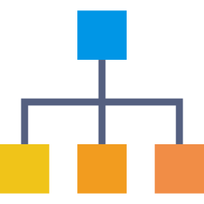
organizational structures
people
communication
product
delivery
direct reports
physical location
product alignment
budget

Slide 48
organizational alignment for shared services
development
(director)
interface development
(manger)
web ui
(manager)
desktop ui
(manager)
infrastructure services
(manger)
networking
Financial
(director)
build & deploy
services
(manger)
operational support
(manager)
provisioning
middleware
expense department
(manager)
software expenses
builds
deploys
call center
tier 2 support
security services
(manger)
internet
identification
backend development (manager)
business layer
(manager)
data layer
(manager)
api layer
(manger)

Slide 49
organizational alignment for hybrid-shared services
development
(director)
application development
(manger)
product A
(manager)
product B
(manager)
infrastructure services
(manger)
networking
Financial
(director)
build & deploy
services
(manger)
provisioning
middleware
expense department
(manager)
software expenses
builds
deploys
security services
(manger)
internet
identification

Slide 50
organizational alignment for product teams
development
(director)
product A
- manager
- network
- provisioning
- middleware
- build
- deploy
- support
- financials
Financial
(director)
expense department
(manager)
product B
- manager
- network
- provisioning
- middleware
- build
- deploy
- support
- financials

Slide 51
organizational alignment using contribution models
 | shared services | hybrid shared services | product teams
BDFL
Meritocracy
Liberal Contribution

Slide 52
product team levers
1. Team ROI
2. Architecture & technologies
3. Collaboration
4. Products and deliverables

Slide 53
implementation
product home page
communication
user forum
request system
delivery
SCM
CI/CD
people
direct messaging
documentation
tutorials and training
demo
developer environment

Slide 54


Home
Adoption
Community
Contribute
Live Demo
Search
Sour Mouth
descriptive catch phrase
Download
Sales Pitch
What the problem this solves?
What are the benefits?
How is it better then other leading products?
Community
user forum
requests
tutorials
Adoption
usage agreement
features
roadmap
Contribute
rules of engagement
repository
documentation
training

Slide 55
Home
Adoption
Community
Contribute
Live Demo
Search
Getting Started with Sour Mouth
descriptive catch phrase
getting started
What’s New
Sour Mouth service now support HTTPS
Please make sure to read our
usage agreement
Resolved issue with setting a custom port number for Sour Mouth service
Feature 1
Description
Feature 2
Description
Feature 3
Description

Slide 56



Home
Adoption
Community
Contribute
Live Demo
Search
Sour Mouth Community
descriptive catch phrase
Latest Discussion
Forum
Topics
topic 1
topic 2
Tutorials
tutorial 1
tutorial 2
Does anyone know if it’s possible to set the port number when starting the Sour Mouth server?
Sure. You can change the port in the config file under {install dir} / sour / server / conf / cfg.json The option is called “port_num”
But if you are trying to use HTTPS you don’t need to change the port number, just set the configuration option “https” to 1
Thanks! Yes. I was trying to use port 443.
Requests
[+] open new request
Latest Requests
request 001
request 002
request 003

Slide 57


Home
Adoption
Community
Contribute
Live Demo
Search
Donating Back
descriptive catch phrase
Project Status
Sour Mouth Service
Please make sure to read our
rules of engagement
build
passing
coverage
97%
Sour Mouth Adapter
build
passing
coverage
65%
Repository
Description
Documentation
Description
Training
Description

Slide 58
1
defining ownership
2
open source contribution models
3
implementing open source in the enterprise
4
pitfalls & anti-patterns

Slide 59
“all inclusive” pitfall
The scope of a product that spans both technology and architectural components has an affect on its …
communication
people
delivery
Support
Development
Adoption
Longevity

Slide 60
“all inclusive” pitfall
CI/CD Ecosystem
build
gradle
maven
scan
style
Rust
NodeJS
container
sql
testing
code coverage
performance
deploy
service
browser
cloud 1
on prem
cloud 2
When this is the open source product

Slide 61
“all inclusive” pitfall
assuming a 2:1 technology to component ratio

Slide 62
“all inclusive” pitfall
CI/CD Ecosystem
build
gradle
maven
scan
style
Rust
NodeJS
container
sql
testing
code coverage
performance
deploy
service
browser
cloud 1
on prem
cloud 2
Make this a separate open source product
Rust

Slide 63
“all inclusive” pitfall
Rust
broker
gradle
maven
Rust
NodeJS

Slide 64
“anti-trust” pitfall
making all the open source projects BDFL because you don’t trust any other team to make changes

Slide 65
“no framing” pitfall
building a open source solution without having all the “framing” in place to help manage the project (e.g.: web site, repo, ci/cd, doc, usage agreement, contribution agreement, etc.)

Slide 66
1
defining ownership
2
open source contribution models
3
implementing open source in the enterprise
4
pitfalls & anti-patterns

Slide 67
Appendix
proprietary

Slide 68
Definition
proprietary

Slide 69
Manifesto for Agile Software Development
individuals and interaction
over
processes and tools
working software
over
comprehensive documentation
able to move quickly and easily
relating to a set of values and supporting principles that direct an individual’s or team’s focus towards behaviors that facilitate success
customer collaboration
over
contract negotiation
responding to change
over
following a plan

Slide 70
Principles behind the Agile Manifesto
working software
Our highest priority is to satisfy the customer through early and continuous delivery of valuable software.
Welcome changing requirements, even late in development. Agile processes harness change for the customer's competitive advantage.
responding
to change
working software
Deliver working software frequently, from a couple of weeks to a couple of months, with a preference to the shorter timescale.
responding
to change

Slide 71
Principles behind the Agile Manifesto
customer collaboration
individuals and interactions
Business people and developers must work together daily throughout the project.
individuals and interactions
Build projects around motivated individuals. Give them the environment and support they need, and trust them to get the job done.
individuals and interactions
The most efficient and effective method of conveying information to and within a development team is face-to-face conversation.
customer collaboration

Slide 72
Principles behind the Agile Manifesto
working software
Working software is the primary measure of progress.
Agile processes promote sustainable development. The sponsors, developers, and users should be able to maintain a constant pace indefinitely.
individuals and interactions
working software
individuals and interactions
Continuous attention to technical excellence and good design enhances agility.

Slide 73
Principles behind the Agile Manifesto
individuals and interactions
Simplicity--the art of maximizing the amount of work not done--is essential.
responding
to change
individuals and interactions
The best architectures, requirements, and designs emerge from self-organizing teams.
responding
to change
At regular intervals, the team reflects on how to become more effective, then tunes and adjusts its behavior accordingly.
individuals and interactions
customer collaboration

Slide 74
What it takes to develop software
software development
people
teams
material
designs
processes
executables
infrastructure
hand-offs
tasks
customers
leader
SMEs
code
ci/cd
expectations
architecture
nodes
networks
How do we make this Agile?

Slide 75
What it takes to be Agile
How do we make this Agile?
people
material
processes
culture
Change the way people think by promoting the Agile mindset in the company.
processes
Develop processes that allow for agility in the company.
structure
Change the organizational structure and the architecture so that they compliment the Agile Manifesto and its supporting principles.

Slide 76

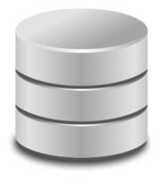
architecture is a direct influence on structure
structure
client request
client request
client request
User interface layer
api layer
business layer
service
component
service
component
module
service
component
module
service
component
module
service
component
module
module
module
module
module
application layer
module
module
module
data layer
module
module
module
message broker
service
component
service
component
service
component
service
component
module
module
module
module

Slide 77
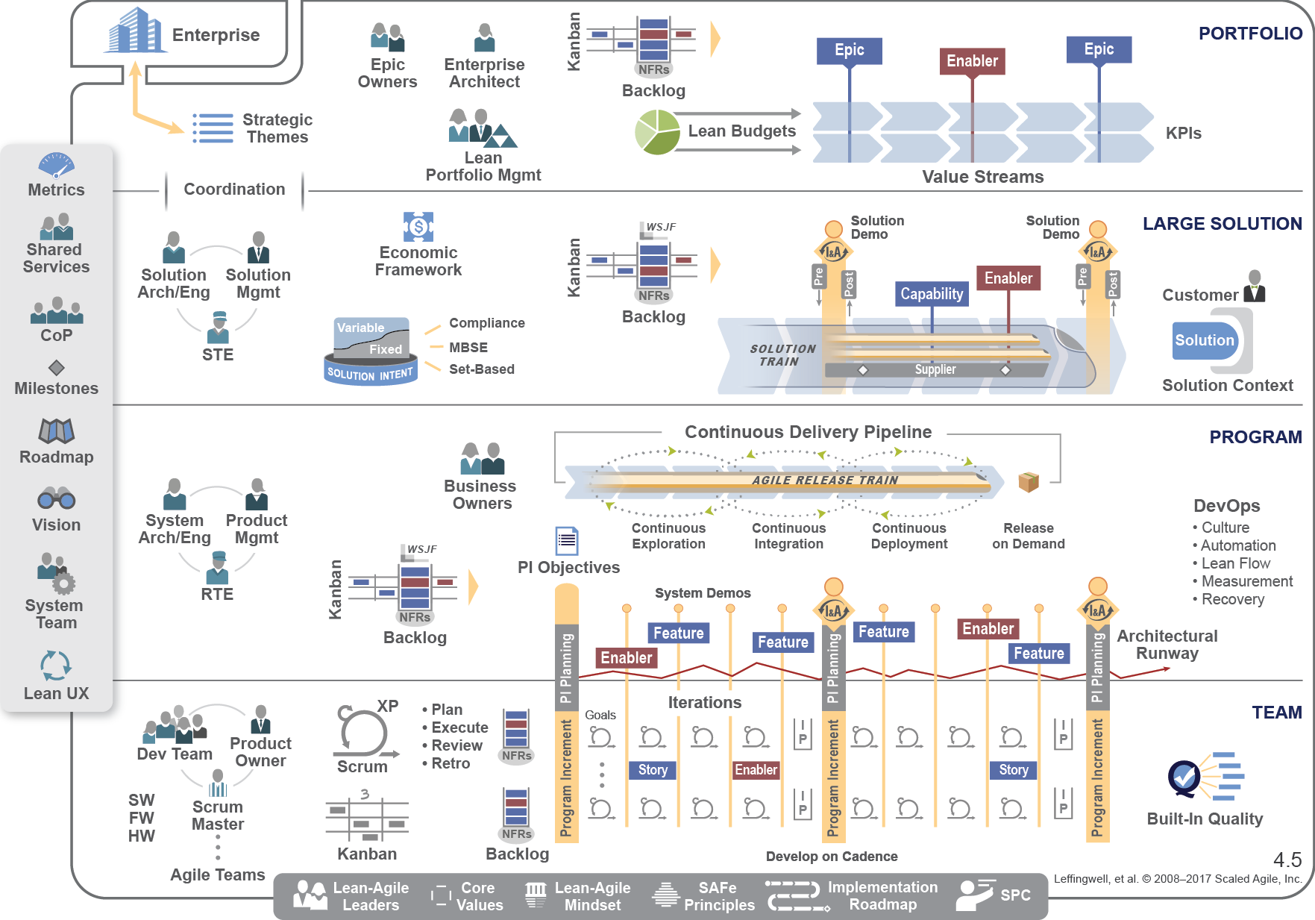
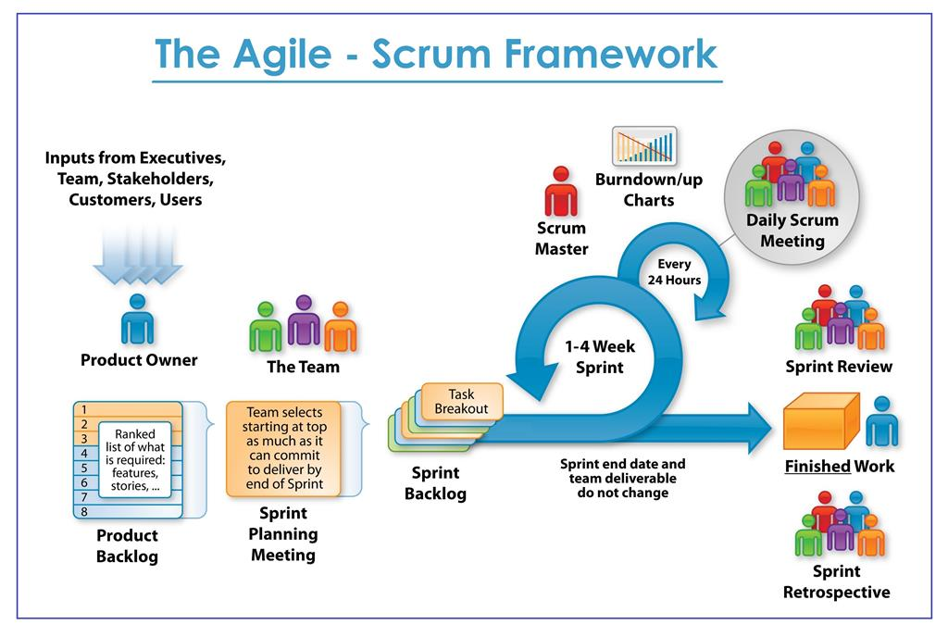
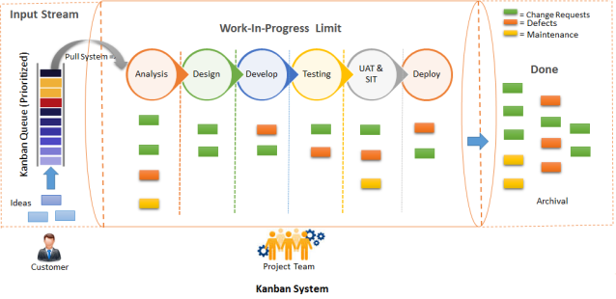
organizational alignment is a direct influence on structure
structure
development
(director)
application development
(manger)
product A
(manager)
product B
(manager)
Infrastructure services
(manger)
networking
Financial
(director)
build & deploy
services
(manger)
operational support
(manager)
provisioning
middleware
expense department
(manager)
software development
builds
deploys
call center
tier 2 support

Slide 78
organizational alignment is a direct influence on structure
structure
development
(director)
application development
(manger)
product A
(manager)
product B
(manager)
Infrastructure services
(manger)
networking
Financial
(director)
build & deploy
services
(manger)
operational support
(manager)
provisioning
middleware
expense department
(manager)
software development
builds
deploys
call center
tier 2 support
development
(director)
product A
(manager, network, provisioning, middleware, build, deploy, support)
Financial
(director)
expense department
(manager)
software development
product B
(manager, network, provisioning, middleware, build, deploy, support)

Slide 79
Characteristics of an Agile company
Customer (or rep) is on the product team
NO external team dependencies
EVERYONE on the team knows the products (including managers)
Agile Architecture
Product team origination alignment
Solutions follow the Open Source model
Treating deliverables as an experiment
MVP

Slide 80
Pitfalls
pit·fall
/ˈpitˌfôl/
noun
Definition
1. a hidden or unsuspected danger or difficulty
2. something we know we shouldn’t be doing, but we do it anyway because it’s
too tempting

Slide 81

Pitfall: Unwarranted Changes
making changes without checking
'Entire aisles are empty': [enter name here] employees reveal why stores are facing a crisis of food shortages
- BUSINESS INSIDER
Implemented an inventory-management system called order-to-self (OTS)
reduces unnecessary inventory
reduced employee moral
individuals and interactions
lower cost
empty shelves
frees up employees to focus on customers
prepared-foods section not refreshed
lost business
customer collaboration
working software
responding
to change

Slide 82
Pitfall: Unwarranted Changes
making changes without checking
Agile is NOT …
software development framework
able to move quickly and easily
relating to a set of values and supporting principles that direct an individual’s or team’s focus towards behaviors that facilitate success
methodology to reduce waste
set of processes and procedures

Slide 83
Pitfall: Refining Overload
down in the weeds before its time
Investment | high
 | medium
 | low
 |  | future | soon | now
 |  | Time to Market

Slide 84
Pitfall: Refining Overload
down in the weeds before its time
In the future
Epic
- large
- general
Coming soon
Story
- medium
- focused
Right now
Tasks
- small
- detailed
low
confidence
high

Slide 85
Pitfall: Refining Overload
down in the weeds before its time
In the future
Epic
Story
- medium
- focused
- low confidence
Coming soon
Story
Tasks
- small
- detailed
- confident
Right now
Tasks
- small
- detailed
- high confidence
rework
low
confidence
high

Slide 86
Pitfall: Refining Overload
down in the weeds before its time
Investment | high
 | medium
 | low
 |  | future | soon | now
 |  | Time to Market

Slide 87
Pitfall: Pigeon Holed Roles
work assignments by SME
work
work
work
work
work
no team dependencies
product
team A
team member dependencies

Slide 88
Pitfall: Dropping the Ball
not prioritizing or defining work
“Agile doesn’t have requirements”
“We do Kanban, so we don’t need to prioritize.”

Slide 89
Pitfall: Dropping the Ball
not prioritizing or defining work
queue
customer collaboration

Slide 90
Pitfall: Dropping the Ball
not prioritizing or defining work
queue
responding
to change

Slide 91
Pitfall: Shared Services
forgoing of true product teams
development
(director)
application development
(manger)
product A
(5)
product B
(6)
Infrastructure services
(manger)
networking
(2)
build & deploy
services
(manger)
operational support
(manager)
provisioning
(2)
middleware
(2)
Builds
(2)
Deploys
(2)
call center
(2)
tier 2 support
(2)
product C
(10)
product D
(8)
cost of 4 products
Category | Headcount
product teams | 29
shared services | 14
managers | 5
total | 48
loses
team dependencies
isolated of knowledge
increased cost of delay
decreased agility

Slide 92
Pitfall: Shared Services
forgoing of true product teams
application development
(manger)
product A
(12)
product B
(13)
product C
(17)
product D
(15)
cost of 4 products
Category | Headcount
product teams | 57
managers | 1
total | 58
gains
shared knowledge
decreased cost of delay
increased agility
increased productivity

Slide 93
Pitfall: Shared Systems
forgoing of team independence
development
(director)
application development
(manger)
product A
(0)
product B
(0)
shared systems
(manger)
Systems team
(75)
cost of system
Category | Cost ($K)
product systems | 0
shared systems | 75
total | 75
loses
system dependencies
reduced innovation
decreased agility

Slide 94


Pitfall: Shared Systems
forgoing of team independence
assumption: conveyor-belt is automated with no delays
reduced costs
ensure security and compliance
reduce maintenance
development
platform
database
platform
build tool
runtime platform
customer
support
system
red
product B

Slide 95


Pitfall: Shared Systems
forgoing of team independence
better aligned product
innovation
bottlenecks
development
platform
database
platform
build tool
runtime platform
customer
support
system
red
product B

Slide 96

Pitfall: Shared Systems
forgoing of team independence
development
(director)
application development
(manger)
product A
(0)
product B
(0)
cost of system
Category | Cost ($K)
product A systems | 75
product B systems | 25
total | 100
gains
system flexibility
increased innovation
increased agility

Slide 97
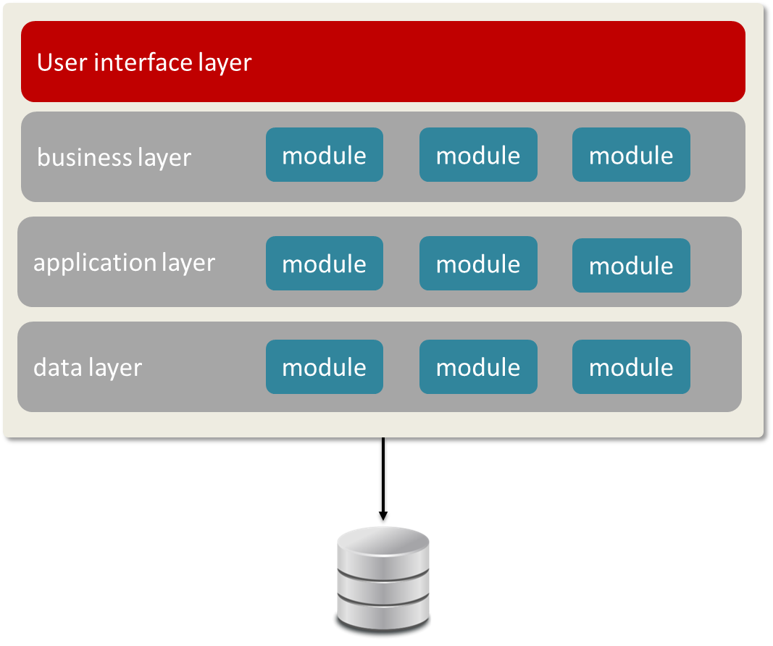
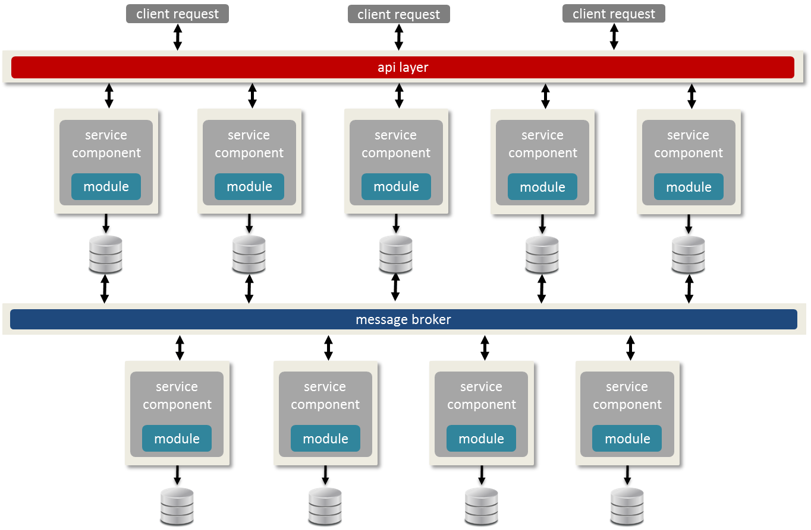
Pitfall
Shared Services & Shared Systems
Microservices
improved stability
decreased cost of delay
increased agility

Slide 98
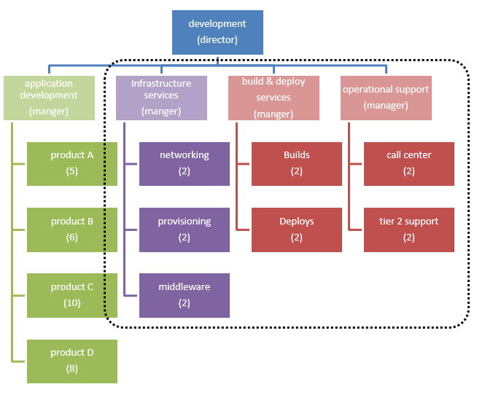
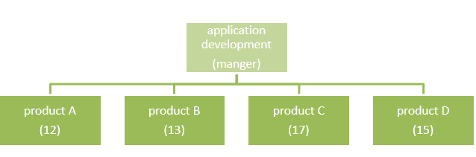
Pitfall
Shared Services & Shared Systems
Product teams
improved stability
decreased cost of delay
increased agility

Slide 99
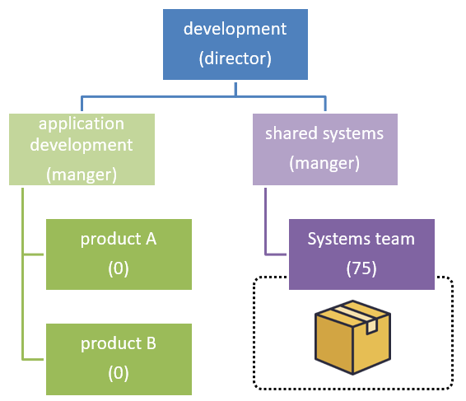
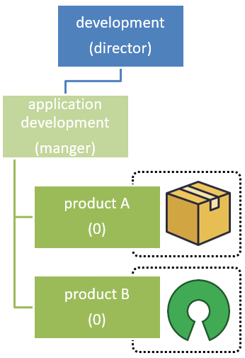
Pitfall
Shared Services & Shared Systems
Product development
improved stability
decreased cost of delay
increased agility

Slide 100
Anti-Pattern: Code Name Agile
Agile – a company objective
executive
management
team leaders
teams
by EOY 60% of company will be Agile
by Nov application development department will be Agile
by July team A will be Agile
by Oct team B will be Agile
team will deliver 80% of committed stories
Notes:
Assumption that bulk processing is faster, but requires a timer which causes data latency

Slide 101
Anti-Pattern: Code Name Agile
Agile – a company objective
company objective (e.g.: 60% of development team will be agile by end of year)
standardized the framework and it’s processes across all the departments and their teams
team metrics (e.g.: average velocity) are measurements for employee goals and objectives
third party or specialized company team determines agile approach for the company
company structure doesn’t reflect agile values and principles
Notes:
Assumption that bulk processing is faster, but requires a timer which causes data latency

Slide 102
Anti-Pattern: Code Name Agile
Agile – a company objective
executive
management
team leaders
teams
15% increase in customer retention
30% increase in customer satisfaction
50% increase in
product usage
80% of deliverables are actively used by customers
Notes:
Assumption that bulk processing is faster, but requires a timer which causes data latency

Slide 103
Anti-Pattern: Code Name Agile
Agile – a company objective
Being Agile is NOT an objective.
However, achieving your goals is an objective, and Agile can help you do that.
Notes:
Assumption that bulk processing is faster, but requires a timer which causes data latency

Slide 104



Anti-Pattern: Framework Frenzy
applying frameworks without structure
processes
framework
culture
training
Notes:
Assumption that bulk processing is faster, but requires a timer which causes data latency

Slide 105
Anti-Pattern: Framework Frenzy
applying frameworks without structure
“I understand what we’re suppose to do, but I don’t see how it has made the process any faster.”
“The issue is that we are not following the framework. If we did we’d be managing our dependencies better.”
processes
“We have more meeting now than we did before becoming Agile”
culture
“We need to focus on MVP (minimal viable product) so let’s get this out the door and refactor it later.”
“The problem is that we didn’t write down the Definition Of Done, so we delivered the wrong feature.”
Notes:
Assumption that bulk processing is faster, but requires a timer which causes data latency

Slide 106
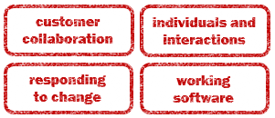
Anti-Pattern: Framework Frenzy
applying frameworks without structure
structure
culture
processes
Notes:
Assumption that bulk processing is faster, but requires a timer which causes data latency

Slide 107


Anti-Pattern: Software Hero
applying software to implement Agile
responding
to change
framework
individuals and interactions
Notes:
Assumption that bulk processing is faster, but requires a timer which causes data latency

Slide 108

Anti-Pattern: Software Hero
applying software to implement Agile
cost
time
responding
to change
effort
price tag
financial guilt
working software
Notes:
Assumption that bulk processing is faster, but requires a timer which causes data latency

Slide 109
Anti-Pattern: Software Hero
applying software to implement Agile
Implement software using agile architecture
experiment with functionality
change functionality as needed
mature
Notes:
Assumption that bulk processing is faster, but requires a timer which causes data latency

Slide 110
Anti-Pattern: Software Hero
applying software to implement Agile
Reduce the investment: cost, time, effort
try open source first
use plugins
stay objective
Notes:
Assumption that bulk processing is faster, but requires a timer which causes data latency

Slide 111

Anti-Pattern: Software Hero
applying software to implement Agile
Don’t be afraid of manual efforts
pilot it manually, then automate
make customer interactions manual
be able to do it manually when the system is down
Notes:
Assumption that bulk processing is faster, but requires a timer which causes data latency

Slide 112
Return on Investment
1. “Is it worth it?”
ROI
2. “What influences ROI?”
expenses
3. “What can we do to reduce
expenses?”
reduce costs
automate
assumptions
inaccurate
3. “What can we do measure
cost of development?”
velocity
burn-down rates
automated CI/CD

Slide 113





Return on Investment
predictive
idea
ROI
development
delivery

Slide 114
Return on Investment
1. “Was it worth it?”
ROI
2. “What influences ROI?”
Did it get to the customer?
ROI
To what degree is the customer using it?
https://www.cio.com/article/2438748/it-organization/the-it-measurement-inversion.html

Slide 115
Return on Investment
1 = 1
actual
idea
development
delivery
ROI

Slide 116
Return on Investment
Reduce Cost of Delay so that …
we know if customer received it, and …
record product utilization, so that …
we can determine ROI as quickly as possible.

Slide 117


Return on Investment
Minimal Viable Product
idea
development
delivery
ROI
idea
development
delivery
ROI
idea
development
delivery
ROI
idea
development
delivery
ROI

Slide 118
Return on Investment
CI / CD
(faster time to market)
idea
development
delivery
ROI
idea
development
delivery
ROI
idea
development
delivery
ROI

Slide 119


Return on Investment
Customer collaboration
(delivery what’s expected)
idea
development
delivery
ROI
idea
development
delivery
ROI
idea
development
delivery
ROI

Slide 120
Return on Investment
Think experiments
Scientific Method
question
hypothesis
testable prediction
test
observations
analysis
conclusion
Product Delivery
request
expectations
development & testing
deliver
monitor and follow-up
analysis
ROI

Slide 121
Customer Satisfaction
We’re seeing
They’re “Saying”
monitoring of usage
perceived value
record system issues
feedback on functionality
trends
product roadmap
validation
clarification
on ROI
determination

Slide 122
Employee Satisfaction
How does employee satisfaction influence ROI?
product delivery
policies and regulations
technologies
people
motivation
knowledge
vested interest

Slide 123
Return on Investment
1. “Was it worth it?”
ROI
2. “What influences ROI?”
Did it get to the customer?
ROI
To what degree is the customer using it?
https://www.cio.com/article/2438748/it-organization/the-it-measurement-inversion.html

Slide 124

Measuring Success
< / >
code coverage
burndown
percent complete
individuals and interactions
customer collaboration
employees
customer
working software
responding
to change
product delivery
product
production

